Slide 1
CodeBreaK 100/101: First report of safety and efficacy of sotorasib in combination with pembrolizumab or atezolizumab in advanced KRAS p.G12C NSCLC
Bob T. Li,¹ Gerald S. Falchook,² Gregory A. Durm,³ Timothy F. Burns,⁴ Ferdinandos Skoulidis,⁵ Suresh S. Ramalingam,⁶ Alexander Spira,⁷ Christine M. Bestvina,⁸ Sarah B. Goldberg,⁹ Rajwanth Veluswamy,¹⁰ Wade T. Iams,¹¹ Alberto A. Chiappori,¹² Charlotte R. Lemech,¹³ Alison R. Meloni,¹⁴ Victoria A. Ebiana,¹⁴ Tian Dai,¹⁴ Diana M. Gauto,¹⁴ Tracy L. Varrieur,¹⁴ Wendy J. Snyder,¹⁴ Ramaswamy Govindan¹⁵
¹Memorial Sloan Kettering Cancer Center, Weill Cornell Medicine, New York, NY, USA; ²Sarah Cannon Research Institute at HealthONE, Denver, CO, USA ³Indiana University School of Medicine, Indianapolis, IN, USA; ⁴University of Pittsburgh Medical Center (UPMC) Hillman Cancer Center, Pittsburgh, PA, USA; ⁵The University of Texas MD Anderson Cancer Center, Houston, TX, USA; ⁶Winship Cancer Institute of Emory University, Atlanta, GA, USA; ⁷US Oncology Research, The Woodlands, TX, USA; ⁸The University of Chicago Medicine, Chicago, IL, USA; ⁹Yale School of Medicine, New Haven, CT, USA; ¹⁰Icahn School of Medicine at Mount Sinai, New York, NY, USA; ¹¹Vanderbilt University Medical Center, Nashville, TN, USA; ¹²Moffitt Cancer Center, Tampa, FL, USA; ¹³Scientia Clinical Research, Randwick, Australia; ¹⁴Amgen Inc., Thousand Oaks, CA, USA; ¹⁵Washington University School of Medicine, St Louis, MO, USA
Presented at World Conference on Lung Cancer (WCLC) 2022 Annual Meeting, August 6-9, 2022; Vienna, Austria.
SC-AT-AMG 510-00188 0822

Slide 2
Diese Präsentation ist urheberechtlich geschützt durch Amgen GmbH. Amgen GmbH stellt dieses Präsentationsmaterial für Angehörige des medizinischen Fachkreises mit Zugang zur Oncology Horizons Webseite zur Verfügung. Es dient ausschließlich zur eigenen Verwendung und darf nicht an Dritte weitergeleitet werden. Es dürfen keine inhaltlichen Änderungen vorgenommen werden.
SC-AT-NP-00098 06.21

Slide 3
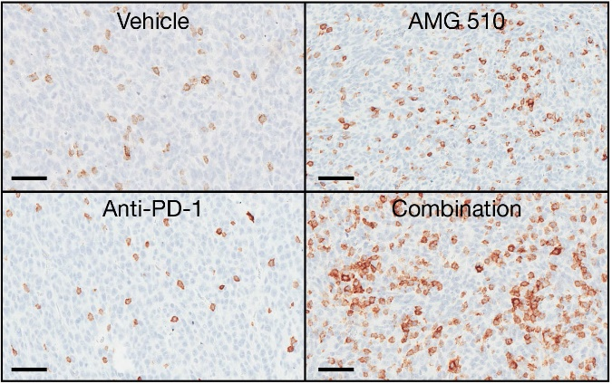
Introduction
    Sotorasib, a first-in-class KRAS^{G12C} inhibitor, is approved as a monotherapy in the US, EU, and other countries for patients with previously treated KRAS G12C-mutated advanced NSCLC¹⁻⁴
CodeBreaK 100⁵ | ORR | DOR | Median OS | Grade 3-4 TRAE | TRAE leading to discontinuation
Pooled Phase 1/2 (N=174) | 41% | 12.3 months | 12.5 months | 21% | 6%
    Sotorasib synergizes with anti-PD-1 to inhibit tumor growth in mice and enhances CD8+ T cell infiltration¹
Vehicle
Sotorasib
Anti-PD-1
Combination
Figures adapted from Canon J, et al. Nature. 2019;575:217-223.
Bob T. Li, MD, PhD, MPH, Memorial Sloan Kettering Cancer Center, New York, NY, USA
****P<0.0001 vs vehicle; #P<0.001 combination vs sotorasib or anti-PD-1 alone by 2-sided Mantel-Cox test
DOR, duration of response; EU, european union; KRAS, Kirsten rat sarcoma virus; NSCLC, non-small cell lung cancer; ORR, objective response rate; OS, overall survival; PD-1, programmed death 1; TRAE, treatment-related adverse event; US, united states.
Li BT, et al. Presented at World Conference on Lung Cancer (WCLC) 2022 Annual Meeting, August 6-9, 2022; Vienna, Austria.

Slide 4
CodeBreaK 100/101 Study Design
Phase 1b multicenter, open-label studies
Key Eligibility
Advanced KRAS G12C-mutated NSCLC
Received (or refused) prior standard therapies
No prior KRAS^{G12C} inhibitor
No active brain mets
Sotorasib*
(oral daily) at:
Sotorasib lead-in 21d or 42d then combination (N = 29)
Concurrent treatment (N = 29)
960 mg
Atezolizumab
1200 mg Q3W
(N = 10)
Atezolizumab
1200 mg Q3W
(N = 10)
Screening/Enrollment
720 mg
360 mg
OR
OR
240 mg
Pembrolizumab
200 mg Q3W
(N = 19)
Pembrolizumab
200 mg Q3W
(N = 19)
*Not all doses were tested for each cohort.
DCR, disease control rate; DOR, duration of response; KRAS, Kirsten rat sarcoma virus; mets, metastases; NSCLC, non-small cell lung cancer; ORR, objective response rate; PK, pharmacokinetics; Q3W, every 3 weeks.
120 mg
Primary endpoints: safety
Key secondary endpoints: ORR, DOR, DCR, PK
Snapshot: April 15, 2022
Here we present first data of lead-in and concurrent sotorasib with pembrolizumab or atezolizumab from CodeBreaK 100/101 with median follow-up time of 12.8 months (range: 1.6, 29.9)
Li BT, et al. Presented at World Conference on Lung Cancer (WCLC) 2022 Annual Meeting, August 6-9, 2022; Vienna, Austria.

Slide 5
Baseline Characteristics
 | Total (N = 58)
Median age, years (range) | 66 (29, 86)
Smoking history, n (%)* | 54 (93)
Median prior lines of therapy, n (range) | 1 (0, 7)
Treated as first-line therapy, n (%) | 12 (21)
Prior anti-PD-(L)1, n (%) | 39 (67)
Prior anti-PD-(L)1 as last prior line, n (%) | 25 (43)
ECOG performance score, n (%)
0 | 11 (19)
1 | 47 (81)
Brain metastasis, n (%) | 18 (31)
Liver metastasis, n (%) | 15 (26)
PD-L1 expression, n (%)†
< 1% | 10 (17)
1% to 49% | 16 (28)
≥ 50% | 21 (36)
Unknown | 11 (19)
*Includes former and current smoking history. †Not available for all patients. ECOG, Eastern Cooperative Oncology Group; PD-L1, programmed death-ligand 1.
Li BT, et al. Presented at World Conference on Lung Cancer (WCLC) 2022 Annual Meeting, August 6-9, 2022; Vienna, Austria.

Slide 6
Safety by Dose: Pembrolizumab Concurrent
TRAE, n (%) | Sotorasib 120 mg (N = 5) |  | Sotorasib 360 mg (N = 8) |  | Sotorasib 720 mg (N = 2) |  | Sotorasib 960 mg (N = 4)
 | Any | Grade ≥ 3 | Any | Grade ≥ 3 | Any | Grade ≥ 3 | Any | Grade ≥ 3
All TRAEs | 5 (100) | 4 (80) | 7 (88) | 6 (75) | 2 (100) | 2 (100) | 3 (75) | 3 (75)
Hepatotoxicity | 2 (40) | 2 (40) | 3 (38) | 2 (25) | 2 (100) | 2 (100) | 3 (75) | 3 (75)
ALT increased | 2 (40) | 1 (20) | 3 (38) | 1 (13) | 2 (100) | 2 (100) | 3 (75) | 3 (75)
AST increased | 2 (40) | 2 (40) | 3 (38) | 0 | 2 (100) | 2 (100) | 3 (75) | 1 (25)
Higher rate of TRAEs than with either monotherapy^{6–8}, with no fatal TRAEs At lower doses of sotorasib, there was a trend towards less liver enzyme elevations, although sample sizes were limited Given the safety data for this combination, sotorasib lead-in was explored
Hepatotoxicity included autoimmune hepatitis, ALT increased, AST increased, ALP increased, bilirubin increased, and GGT increased.
ALT, alanine aminotransferase; ALP, alkaline phosphatase; AST, aspartate aminotransferase; GGT, gamma-glutamyltransferase; TRAE, treatment-related adverse event.
Li BT, et al. Presented at World Conference on Lung Cancer (WCLC) 2022 Annual Meeting, August 6-9, 2022; Vienna, Austria.

Slide 7
Safety Summary: Lead-in versus Concurrent
 | Sotorasib + Atezolizumab Lead-In (N = 10) | Sotorasib + Atezolizumab Concurrent (N = 10) | Sotorasib + Pembrolizumab Lead-In (N = 19) | Sotorasib + Pembrolizumab Concurrent (N = 19)
TRAE, any grade, n (%) | 10 (100) | 9 (90) | 15 (79) | 17 (89)
Grade 3 | 3 (30) | 5 (50) | 10 (53) | 14 (74)
Grade 4* | 0 | 1 (10) | 0 | 1 (5)
TRAE leading to sotorasib and/or IO discontinuation, n (%) | 1 (10) | 5 (50) | 6 (32) | 10 (53)
Median duration of sotorasib, months (min, max) | 6.5 (1, 18) | 4.4 (1, 14) | 2.8 (1, 15) | 4.9 (2, 30)
Median duration of combination, months (min, max)^{ǂ} | 1.5 (0, 18) | 2.5 (1, 14) | 0.7 (1, 15) | 2.3 (1, 9)
Hepatotoxicity grade ≥ 3, median onset, days (range) | 50 (28, 93) | 67 (36, 147) | 73 (45, 127) | 51 (29, 190)
Lead-in had lower incidence of Grade 3-4 TRAEs and TRAEs leading to discontinuation than concurrent Grade 3-4 hepatotoxicity first occurrence was outside DLT window† in 88% of patients; 97% of events resolved with corticosteroids, treatment modification, and/or discontinuation The incidence of hepatotoxicity TRAEs was similar in IO-naïve versus IO-pretreated patients
Hepatotoxicity included ALT increased, AST increased, ALP increased, bilirubin increased, GGT increased; also hepatitis, liver function test increased, drug-induced liver injury, transaminases increased for sotorasib+atezolizumab; also hepatic enzyme increased, immune-mediated hepatitis for sotorasib lead-in+pembrolizumab; also autoimmune hepatitis for sotorasib+pembrolizumab concurrent.
*Grade 4 TRAEs were ALT increased (n = 1; related to sotorasib and atezolizumab), and AST increased (n = 1; related to sotorasib).
^{ǂ}Duration of combination calculated for patients receiving both sotorasib and IO; one patient in a lead-in cohort did not receive IO and not included.
†DLT window was 21 days following initiation of combination treatment. IO, immune-oncology therapy.
Bob T. Li, MD, PhD, MPH, Memorial Sloan Kettering Cancer Center, New York, NY, USA
Li BT, et al. Presented at World Conference on Lung Cancer (WCLC) 2022 Annual Meeting, August 6-9, 2022; Vienna, Austria.
Notes:
Pembro and atezo combos_WCLC LBA_5.26.22_FINAL: 1-A-3, pg2 table|

Slide 8
Safety for Sotorasib Lead-in + Pembrolizumab
TRAE*, n (%) | Sotorasib 120 mg (N = 3) |  | Sotorasib 240 mg (N = 5) |  | Sotorasib 360 mg (N = 11)
 | Any | Grade ≥ 3 | Any | Grade ≥ 3 | Any | Grade ≥ 3
All TRAEs | 3 (100) | 3 (100) | 3 (60) | 1 (20) | 9 (82) | 6 (55)
ALT increased | 2 (67) | 2 (67) | 1 (20) | 1 (20) | 6 (55) | 3 (27)
AST increased | 2 (67) | 2 (67) | 1 (20) | 1 (20) | 6 (55) | 2 (18)
ALP increased | 2 (67) | 0 | 0 | 0 | 3 (27) | 2 (18)
Diarrhea | 1 (33) | 0 | 1 (20) | 0 | 6 (55) | 1 (9)
Arthralgia | 1 (33) | 0 | 0 | 0 | 2 (18) | 0
Nausea | 0 | 0 | 0 | 0 | 4 (36) | 0
Fatigue | 0 | 0 | 0 | 0 | 4 (36) | 0
Hypokalemia | 0 | 0 | 0 | 0 | 3 (27) | 2 (18)
Decreased appetite | 0 | 0 | 0 | 0 | 3 (27) | 0
Headache | 0 | 0 | 0 | 0 | 2 (18) | 0
Hepatotoxicity | 2 (67) | 2 (67) | 2 (40) | 1 (20) | 6 (55) | 5 (45)
Overall safety data from lead-in and concurrent cohorts support lower dose sotorasib and lead-in administration for better tolerability
*Any grade TRAE or grade ≥ 3 TRAE occurring in ≥ 1 patient in any dose cohort.
ALT, alanine aminotransferase; ALP, alkaline phosphatase; AST, aspartate aminotransferase; TRAE, treatment-related adverse event.
Li BT, et al. Presented at World Conference on Lung Cancer (WCLC) 2022 Annual Meeting, August 6-9, 2022; Vienna, Austria.

Slide 9
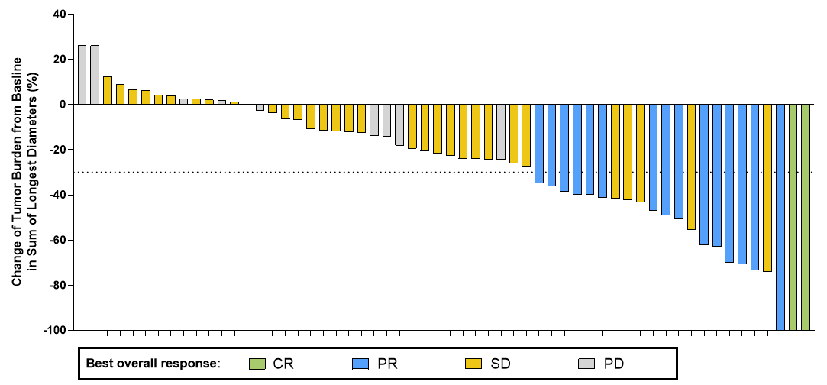
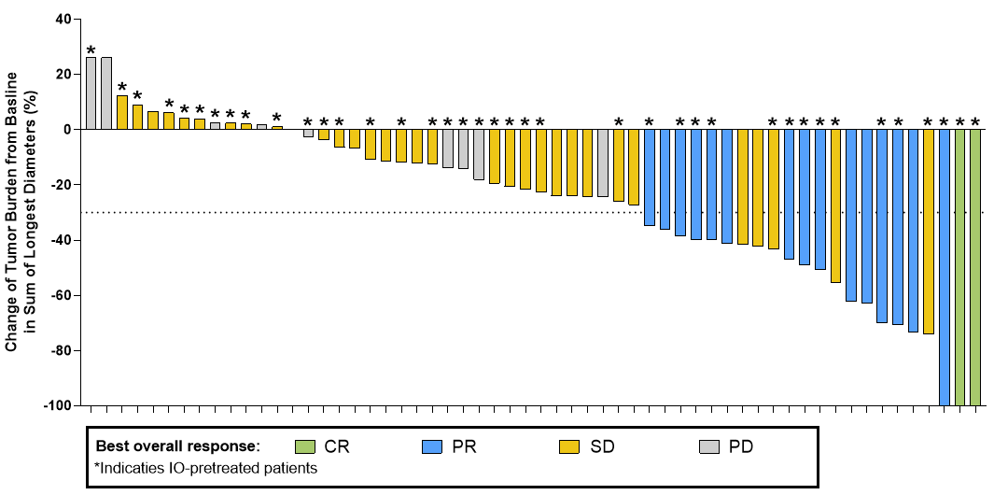
Efficacy
ORR: 17/58 (29%; 95% CI: 18, 43)
DCR: 48/58 (83%; 95% CI: 71, 91)
Median depth of response*: 51%
Deep and durable responses were observed for this combination across all cohorts, including at low doses Among the 17 responders, median duration of response was 17.9 months (95% CI: 5.6, NE)
Response was similar in IO-naïve and IO-pretreated patients
*Median depth of response among responders. CI, confidence interval; CR, complete response; DCR, disease control rate; IO, immune-oncology therapy; NE, not estimable; ORR, objective response rate; PD, progressive disease; PR, partial response; SD, stable disease.
Li BT, et al. Presented at World Conference on Lung Cancer (WCLC) 2022 Annual Meeting, August 6-9, 2022; Vienna, Austria.

Slide 10
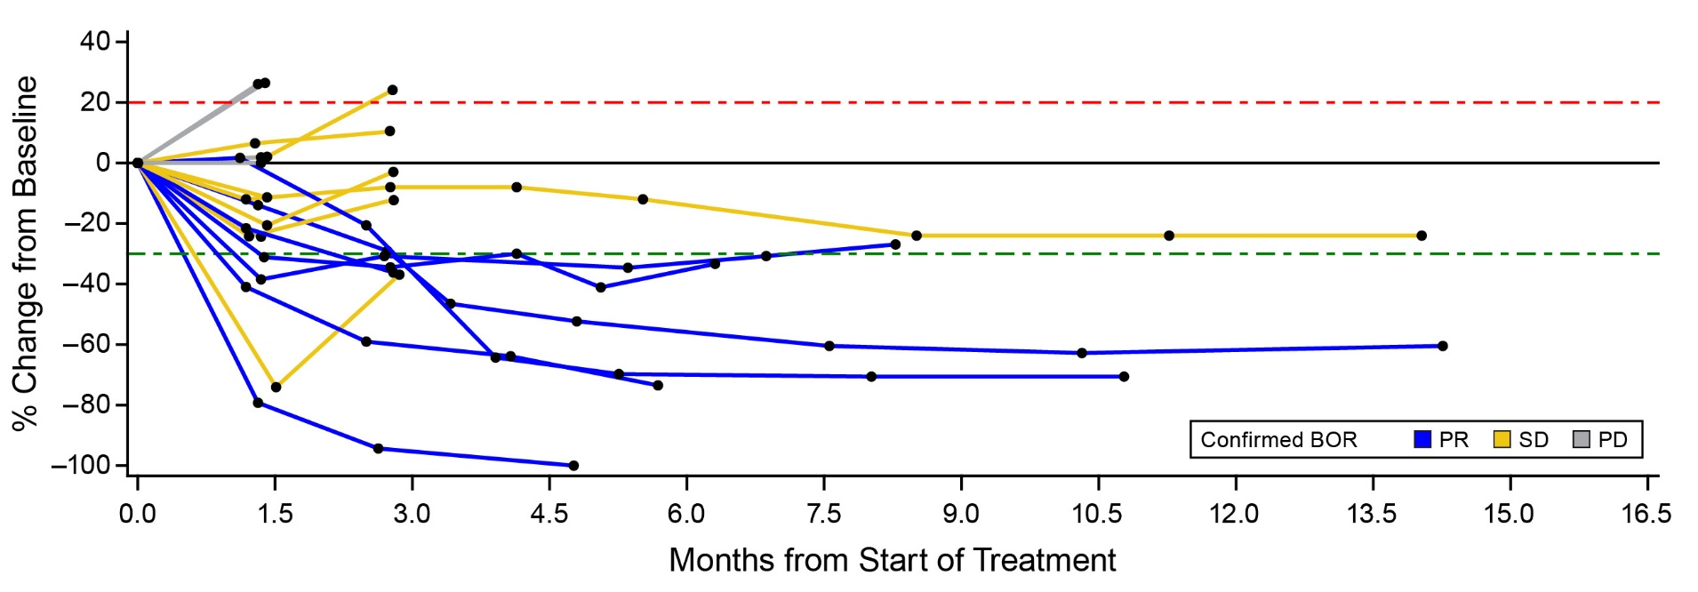
Efficacy for Sotorasib Lead-In + Pembrolizumab
Durable clinical benefit observed with sotorasib lead-in + pembrolizumab, with deep responses Low dose sotorasib lead-in + pembrolizumab is being pursued given its safety and efficacy profile
BOR, best overall response. PD, progressive disease; PR, partial response; SD, stable disease.
Li BT, et al. Presented at World Conference on Lung Cancer (WCLC) 2022 Annual Meeting, August 6-9, 2022; Vienna, Austria.

Slide 11
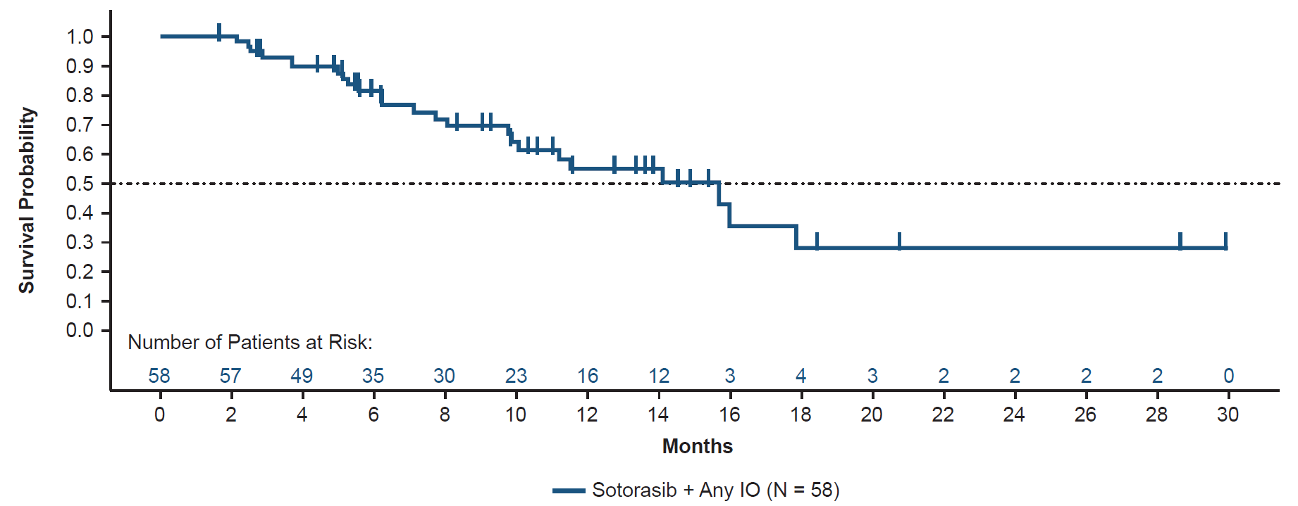
Overall Survival: Sotorasib + any IO
Median OS: 15.7 months (95% CI: 9.8, 17.8)
CI, confidence interval; IO, immune-oncology therapy; OS, overall survival.
Bob T. Li, MD, PhD, MPH, Memorial Sloan Kettering Cancer Center, New York, NY, USA
Li BT, et al. Presented at World Conference on Lung Cancer (WCLC) 2022 Annual Meeting, August 6-9, 2022; Vienna, Austria.

Slide 12
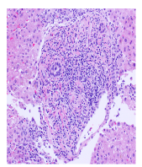
Case Study: Sotorasib 960 mg Concurrent with Pembrolizumab
Partial response was achieved at 6 weeks; patient developed grade 1 liver enzyme elevations Grade 3 AST/ALT elevations led to prednisone administration, sotorasib dose reduction and discontinuation of pembrolizumab Complete response achieved with sotorasib 240 mg, and maintained > 2 years; patient continuing sotorasib
Liver biopsy: liver injury with immune infiltration
ALT, alanine aminotransferase; AST aspartate aminotransferase.
Li BT, et al. Presented at World Conference on Lung Cancer (WCLC) 2022 Annual Meeting, August 6-9, 2022; Vienna, Austria.

Slide 13
Conclusions
In mostly IO-pretreated patients, sotorasib with atezolizumab or pembrolizumab led to a higher incidence of grade 3-4 TRAEs than observed with monotherapy^{6–8}
      In the initial sotorasib + pembrolizumab concurrent studies, lower sotorasib doses trended toward less hepatotoxicity TRAEs including fewer grade ≥ 3 events
      Sotorasib lead-in had lower rates of grade 3-4 TRAEs and TRAEs leading to discontinuation compared with concurrent administration
      Grade 3-4 TRAEs were primarily liver enzyme elevations. Nearly all hepatotoxicity events occurred outside the DLT window and resolved with corticosteroids, treatment modification, and/or discontinuation
  Lead-in cohorts demonstrated durable clinical activity and depth of response
  Among 17 responders, median duration of response was 17.9 months (95% CI: 5.6, NE)
Low dose sotorasib as lead-in followed by combination with pembrolizumab will be further studied in 1L patients with advanced NSCLC to assess benefit-risk
1L, first-line; CI, confidence interval; DLT, dose-limiting toxicity; IO, immune-oncology therapy; NE, not estimable; NSCLC, non-small cell lung cancer; TRAE, treatment-related adverse event.
Li BT, et al. Presented at World Conference on Lung Cancer (WCLC) 2022 Annual Meeting, August 6-9, 2022; Vienna, Austria.

Slide 14
Acknowledgements
The authors thank the patients and their families, clinical trial staff, and the study teams for contributing to this trial.
These studies were funded by Amgen Inc. (CodeBreaK 100: NCT03600883; CodeBreaK 101: NCT04185883)
Medical writing support was provided by Lisa Denny, PhD and Lee Hohaia, PharmD of ICON plc, Blue Bell, PA, USA, Maya Shehayeb, PharmD and Liz Leight, PhD, employees of Amgen Inc., and graphics assistance was provided by Bob Dawson, with funding by Amgen Inc.
References
Canon J, et al. Nature. 2019;575:217-223.
LUMAKRAS® (sotorasib). Prescribing Information. Thousand Oaks, CA, Amgen Inc., 2021.
LUMYKRAS® (sotorasib). Summary of Product Characteristics, Cambridge, UK, Amgen Ltd., 2021.
LUMYKRAS® (sotorasib). European Medicines Agency. Available at https://www.ema.europa.eu/en/medicines/human/EPAR/lumykras. Accessed June 6, 2022.
Dy GK, et al. Oral Presentation at: 2022 AACR Annual Meeting; April 8-13, 2022, New Orleans, LA. Abstract CT008.
Hong DS, et al. N Eng J Med. 2020;383:1207-1217.
Mok TSK, et al. Lancet. 2019;393:1819-1830.
Herbst RS, et al, N Engl J Med. 2020; 383:1328-1329.
LUMAKRAS® and LUMYKRAS® are registered trademarks of Amgen Inc.
Li BT, et al. Presented at World Conference on Lung Cancer (WCLC) 2022 Annual Meeting, August 6-9, 2022; Vienna, Austria.

